Slide 1
Financial Aid At-A-Glance
Chicago-Kent College of Law ~ Conviser Law Center

Slide 2
FAFSA Free Application for Federal Student Aid
studentaid.gov/h/apply-for-aid/fafsa
2025-2026 FAFSA available in October, 2024
Summer Start students must complete both 2024-2025 & 2025-2026 FAFSA.
Chicago-Kent School Code = E00773.
Must meet eligibility requirements.

Slide 3
Cost of Attendance Budget
Billable Expenses:
Tuition and fees
+
Non-billable Expenses:
Room and board (Rent, Utilities, Food)
Books and Supplies
Transportation (Public & Parking)
Miscellaneous Expenses (Laundry, Entertainment)
=
Cost of Attendance (COA)
**Total Financial Aid Award Cannot Exceed COA!**

Slide 4
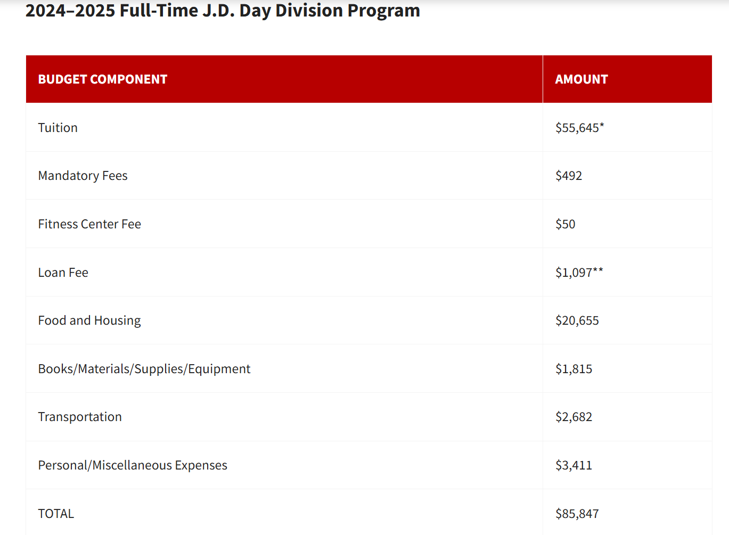
24-25 Cost of Attendance- 1L - FT

Slide 5
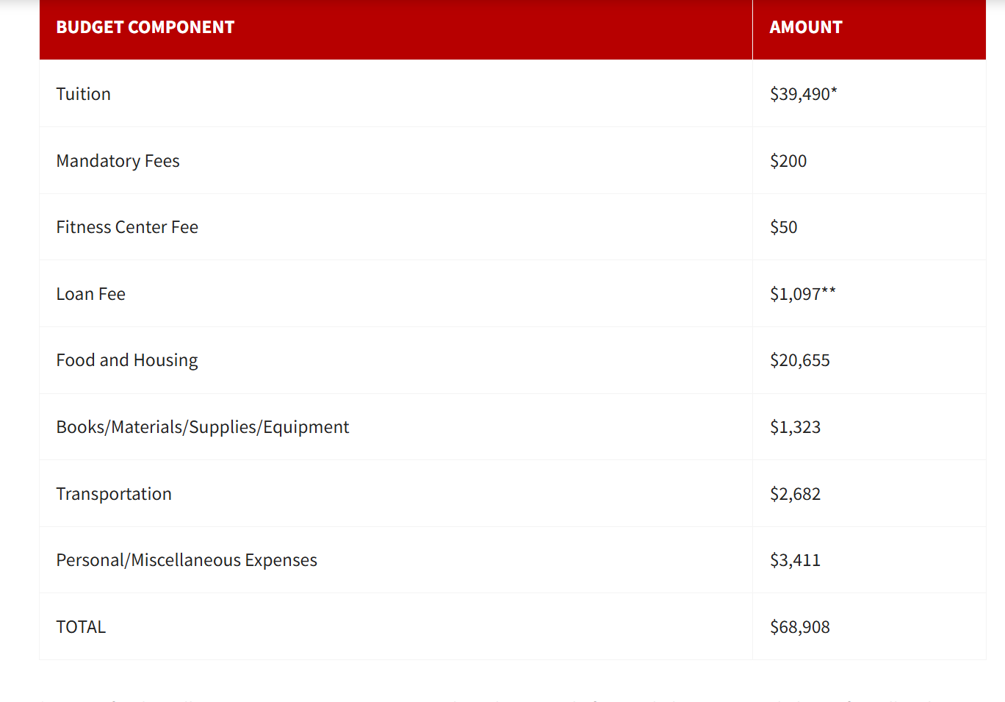
24-25 Cost of Attendance- 1L -PT

Slide 6
Award Review and Acceptance
Students will receive a Financial Aid Award Notification with instructions to view their award offer(s) and accept, modify or decline your offer(s).
Must be enrolled at least half-time (6 credit hours for the Fall and Spring semesters and 3 credit hours for the Summer term).
Summer start students will receive a separate award notification for the summer term.

Slide 7
Sources of Financial Aid
Scholarships
Private Education Loans
Federal Student Aid
Unsubsidized Stafford Loan – Max $20,500 annually
Graduate PLUS Loan – Up to total Cost of Attendance
http://www.annualcreditreport.com
Federal Work Study (FWS)

Slide 8
Current Loan Interest & Fees STUDENTAID.GOV
Loan Type | Interest Rate 2024-2025 Loans first disbursed on or after 7/1/24 and before 7/1/25 | Origination Fees On or after 10/1/24 and before 10/1/25 | Grace Period
Federal Direct Unsubsidized Loan – not need based | 8.08% Accrues while in school | 1.057% Subtract from accepted loan amount | 6 months after graduation or if cease to be enrolled at least half time
Federal Direct Graduate Plus Loan – credit based and not need based | 9.08% Accrues while in school | 4.228% Subtracted from accept loan amount | 6 months after graduation or if cease to be enrolled at least half time

Slide 9
Sample Award – 1L Day (FT)
Chicago-Kent Scholarship $20,000
Federal Work Study $ 5,000
Federal Direct GradPLUS Loan $40,347
Federal Direct Unsubsidized Loan $20,500
TOTAL $85,847

Slide 10
Example Estimated 1L (FT) Costs
Tuition - $55,645
Fees - $ 612
TOTAL $56,257
Chicago-Kent Scholarship - $20,000
Balance - $36,257

Slide 11
External Scholarships
kentlaw.iit.edu
Free online scholarship search websites:
www.fastweb.com
www.supercollege.com
www.finaid.org
www.salliemae.com
scholarships.com
NEVER pay for scholarship searches & information!

Slide 12
Required Documents
For first-time borrowers of federal financial aid at Chicago-Kent
Loan Agreement (Master Promissory Note) for each Federal Direct Loan type you accept
One-time online Loan Entrance Counseling
Studentaid.gov
Unsatisfied requirements on the Financial Aid Dashboard of your Illinois Tech student portal

Slide 13
Financial Aid Disbursements
Financial Aid (scholarships and federal student loans) is disbursed in equal installments and applied directly to your Chicago-Kent student account before the start of each semester if all requirements are complete.
This does not necessarily mean you will receive a refund before the start of classes.

Slide 14
Refunds
The Refund process managed by the Student Accounting Office.
If you have a credit balance (excess of funds) after all financial aid is applied to your student account and your billable expenses (tuition and fees) are paid for the semester, the Student Accounting Office will process a refund.
For a timeline of your refund, to discuss charges on your student account, or for information on setting up direct deposit or payment plans, please contact the Student Accounting Office at sa@iit.edu or at (312) 567-3794.

Slide 15
AccessLex Center for Education & Financial Capability
Personal Finance Program for Law Students that offers on-campus and online resources for every step of your law school journey.
Scholarship Drawings
Offer one-on-one counseling
Budgeting
Topics specific to 1Ls, 2Ls and 3Ls
Loan Repayment, PSLF and transitioning from law school to employment as you launch your career.
AskEDNA.Accesslex.org

Slide 16
FERPa Family Educational Rights & Privacy Act
IIT.EDU
FERPA Release Form
Grant a third-party (parents/spouse) permission to access financial aid records

Slide 17
Questions?
Financial Aid Office
Illinois Tech
Chicago-Kent College of Law
312-567-7219
Finaid@iit.edu
https://calendly.com/illinois-tech-office-of-financial-aid

